Slide 1
Lecture 7 Generalised Linear Mixed Models

Slide 2
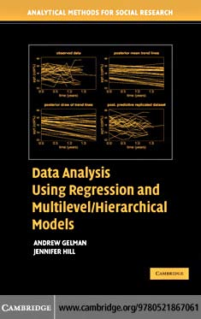
multilevel logistic regression
State level opinions from national polls
Gelman & Hill, Chapter 14

Slide 3

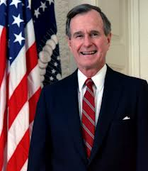
simplified to republicans versus democrats
George H Bush
Michael Dukakis
binary data

Slide 4
Data set
1988 election opinion polls
binary
1 = preferred Bush (Republican)
0 = preferred Dukakis (Democrat)
multilevel
state level
predictor variables
we will use three: race, sex and age

Slide 5
Exercise 7.1
Read in the data from the file
Take a quick look at them
Use a glm to answer the question:
Were black voters and female voters more or less likely to prefer George Bush? (additive model)

Slide 6
Assumptions of GLMs again
(and things to do)
The model makes biological sense (think critically!)
Additivity (consider transformations, interactions, GLMs)
Linearity (plot data, transformations, GLMs)
Independence of errors (blocking, mixed effects models)
Homoscedasticity – equal variance of errors (GLMs, weighted least squares)
Allow Gaussian or non-Gaussian distributions for the residuals (e.g. Binomal, Poisson, Gamma).

Slide 7
GLMMs
Allow incorporation of both fixed and random effects into GLM structure
Use glmer function
> mod <- glmer(y ~ x1 +x2 + (1|group), data=dat, family=binomial(link=logit))
Specify the grouping structure
And the link function
Specify the error distribution

Slide 8
Logit links
Useful for Binomial models
Good link functions = response goes from -∞ to +∞
logit(p) = log[p/(1-p)]
logit(0) = -∞; logit(1) = ∞
Can get logit(p) in R with q=qlogis(p)
The inverse is obtained with
p=plogis(q)

Slide 9
Exercise 7.2
Use ggplot to understand how black female voters vote in different states
Now use a glmer to test the same relationships:
Were black voters and female voters more or less likely to prefer George Bush?

Slide 10
Interpreting the output
Generalized linear mixed model fit by maximum likelihood (Laplace Approximation) [glmerMod]
Family: binomial ( logit )
Formula: bush ~ female + black + (1 | state)
Data: polls
AIC BIC logLik deviance df.resid
2664.7 2687.1 -1328.3 2656.7 2009
Random effects:
Groups Name Variance Std.Dev.
state (Intercept) 0.1687 0.4108
Number of obs: 2013, groups: state, 48

Slide 11
Interpreting estimates
Fixed effects:
Estimate Std. Error z value Pr(>|z|)
(Intercept) 0.4377 0.1015 4.31 1.6e-05
female1 -0.0931 0.0951 -0.98 0.33
black1 -1.7397 0.2095 -8.30 < 2e-16
Correlation of Fixed Effects:
(Intr) femal1
female1 -0.552
black1 -0.118 -0.005

Slide 12
Exercise 7.3
Do different voting patterns among females of different states explain some of the variation? (new random effects structure required…)

Slide 13
Diagnostics checking
Hard with GLMMs (especially binary ones) but there are options
binned.plot() – for binary data.
Check for residual over-dispersion
Check if the random effects are normally distributed (as before)

Slide 14
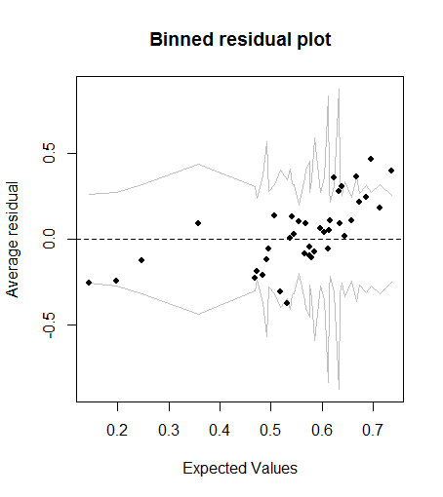
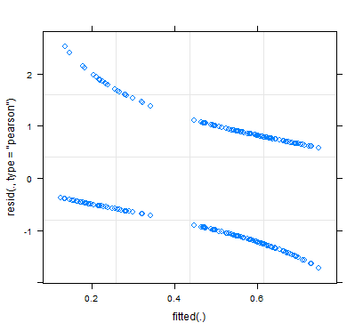
Diagnostic plots

Slide 15
Over-dispersion
Binomial and Poisson models assume that the variance is a function of the mean
Once you know the mean, you should be able to estimate the variance!
Residual deviance ≈ Residual degrees of freedom.
Not ideal for binary models but indicative

Slide 16
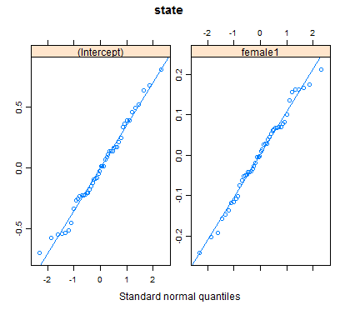
Check the random effects
Normally distributed?
> qqmath(ranef(mod.polls.glmm1), type=c('p', 'r'))

Slide 17
Exercise 7.4
Using your last GLMM:
Check residual vs fitted plots residuals
Check binned plot of residuals
Check for overdispersion of residuals
Check whether random effects are normal

Slide 18
Poisson glmms
Used for count data – residuals predicted to be drawn from a poisson distribution
> mod <- glmer(y ~ x1 +x2 + (1|group), data=dat, family=poisson(link=log))

Slide 19
Overdispersion again
Overdispersion is a common problem in Poisson models where the actual variance exceeds the mean (recall Poisson models assume μ = σ = λ, a single parameter).
Overdispersion can be caused by:
missing covariates,
non-independent (aggregated) data, or
an excess frequency of zeroes (zero-inflation).

Slide 20
Observation level random effect
An OLRE assumes that some of the excess variation in the poisson data is actually a distribution process that needs to be accounted for
So the OLRE is a normally distributed variance term (hence random) that gets added into a model to account for this excess variance: ε_{OLRE}~ N(o,σ_{z}²)
It can be easily added.
pest$indx <- 1:nrow(pest)
glmer(Y~X+ … + (1|indx), data=pest,family=poisson(link=log))

Slide 21
Observation level random effect
OLREs are good at certain types of data problem but not at others
Good for:
Variance > mean in a poisson-type distribution
Aggregation in count data (negative binomial distributions)
Bad for:
Data with serious zero inflation (many zero values)
OLREs can also be used for overdispersed poisson data where no other random grouping parameter is apparent; this may make them a better solution than pseudo-distributions (e.g. pseudopoisson) because they yield proper maximum likelihood estimates.

Slide 22

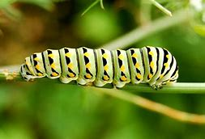

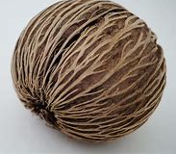
The pest dataset
Forest composition depends substantially on the fate of seedling trees. Recruitment of seedling trees depends on availability of seeds and also survival through disturbance hazards and competition. Seedling survival may be heavily impacted by insect herbivory and fungal pathogen attack. But are both processes important in forest ecosystems? Or is one of these hazards overriding in its influence?
Notes:
22

Slide 23
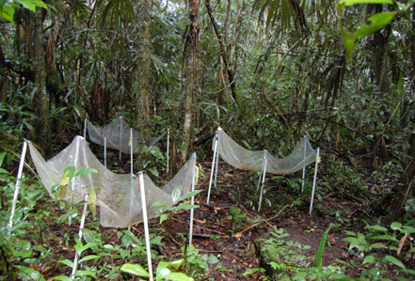
The pest dataset
120 m
Seed Trap
Insecticide
Control
(water)
Seed Trap
Fungicide
Seed Trap
1m
120 m
1m
Notes:
23

Slide 24
Exercise 7.5
Use ggplot to look at how number of seedlings responds to treatments across stations
Fit a GLMM to the pest data set to answer the following questions
What is effect of insecticide and fungicide on number of seedlings?
Does the model fit the data well?
What might you do to improve the model fit? (think model covariates, OLREs)

Slide 25
Inference: Bootstrapping with GLMMs
Bootstrap approach is similar to that with a Gaussian response.
Parametric bootstrap still makes assumptions about relationships between means and variances (i.e. overdispersion is STILL a problem)

Slide 26
Exercise 7.6
Evaluate whether treatments are affecting survival using LRTs
Evaluate the same using bootstrapped confidence intervals. Compare the models without and with the individual-level random effect

Slide 27
Making predictions with GLMs
Use the same function predict as for lm
Some differences!
One extra argument is ‘type’. This specifies what scale you want the prediction on
The data scale (‘response’)
The linear predictor scale (‘link’)
For example: predict(mod5, newdata=newdata, type=‘response’)

Slide 28
Plotting with standard errors
There is no interval argument for predict.glm()
Can get standard errors, and calculate the confidence intervals manually.
Standard errors are on link scale – and are asymmetrical on the response scale.
Therefore need to do the prediction on the link scale (log or logit usually) and back-transform.
Remember to add standard errors to UNTRANSFORMED predictions.

Slide 29
Calculating the expected values
Extract the model matrix (X), using model.matrix()
Calculate the expected values on the linear predictor scale as X %*% fixef(model)
Add on the random effect BLUPs if you want.
You can also use the built-in predict function for the expected values (not confidence intervals)

Slide 30
Calculating the confidence intervals
Extract the variance covariance matrix with vcov(mod)
Calculate the standard errors as sqrt(diag(X %*% VCV %*% t(X))
Add or subtract the standard errors
Back transform to the data scale.
NB: for unknown groups you need to add on the variance components BEFORE you take the root in step 2 (recall previous lesson)

Slide 31
Exercise 7.7
Fit a model to the plantdamage2.csv data on seedling survival. Please note the structure of the data: four seedlings were planted per treatment in each greenhouse and their survival was observed after some fixed period of time.
Calculate the predictions and confidence intervals for all treatments in the first four greenhouses
for a known shadehouse
For an unknown shadehouse
Plot the results in fitted and back-transformed ranges.

